Slide 1
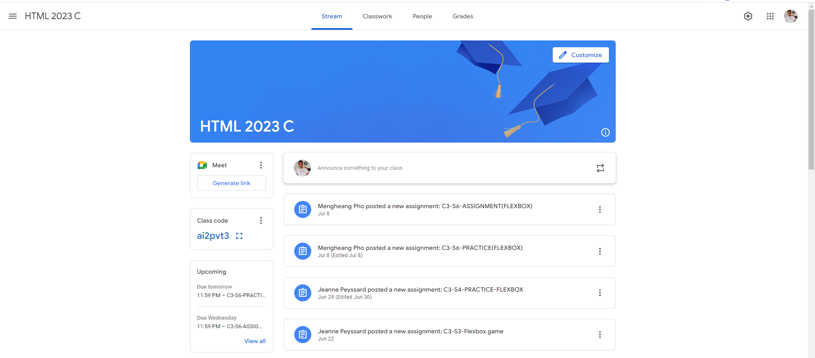
Identify root components of website below

Slide 2
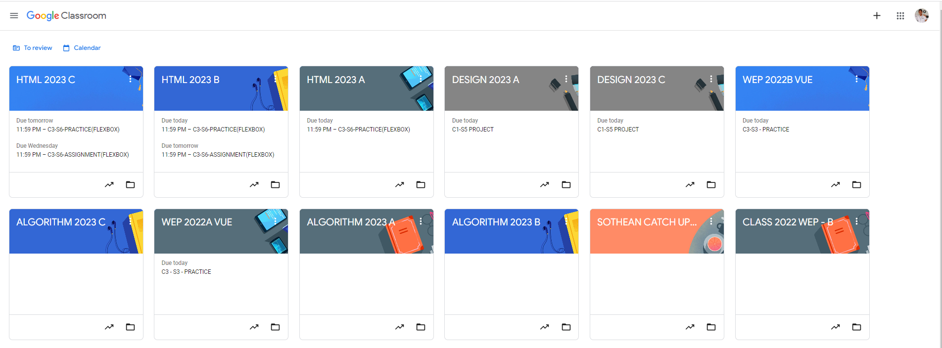
Root div
- Height: 100vh
content
nav
Flex: 0
header
Flex: 0
Flex: 1

Slide 3
Div class=‘’nav’’
flex-start
center
flex-end
Nav-left
Nav-mid
Nav-right

Slide 4
Div class=‘’Class-title’’
Div Customize
Flex-end
Flex start
Div title
icon
Flex-end

Slide 5
.container
Container left
Container right

Slide 6
.container
Right-container
Flex-direction row

Slide 7
.container
Left-continer
Flex-direction column
Left container

